Slide 1
Assignment-3
Keshav Gambhir 2019249
Tanmay Rajore 2019118

Slide 2
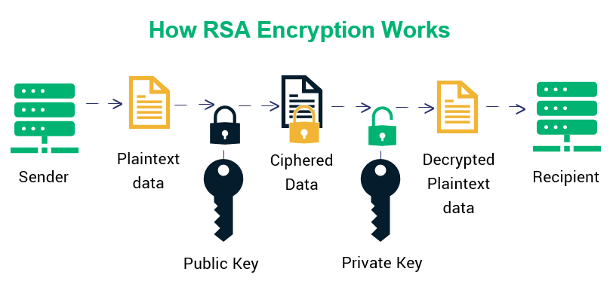
Introduction
Implemented a Public key distribution authority to distribute public key for secure communication
Implemented RSA algorithm for generating public key and private keys

Slide 3
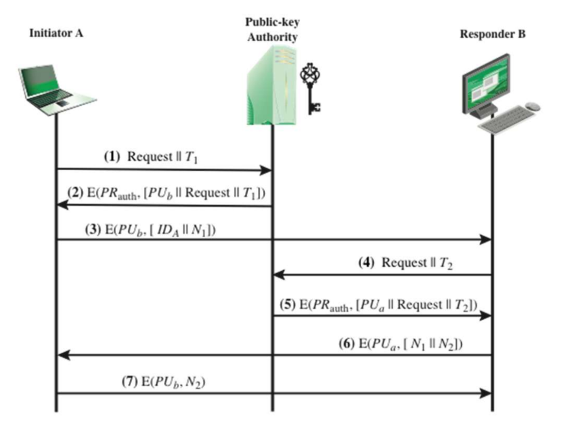
Explanation of working

Slide 4
Initially clients registers their public key with PKDA
Initiator sends the public key request to PKDA
It establishes a secure connection with the other client
Communicates over the secure channel using a public private RSA keys

Slide 5
Implementation of RSA algorithms
Let p, q be 2 prime numbers
n = p * q
phi_n = (p-1)*(q-1)
e = x ∊ {2 …. phi_n-1} where gcd(x,phi_n) == 1
(e * d) % phi_n = 1
⇒ d = modular_inverse(e,phi_n)

Slide 6
Use of HMAC
HMAC stands for hashed based message authentication code
Used to check the message integrity and to verify that the message is coming from the correct authority

Slide 7
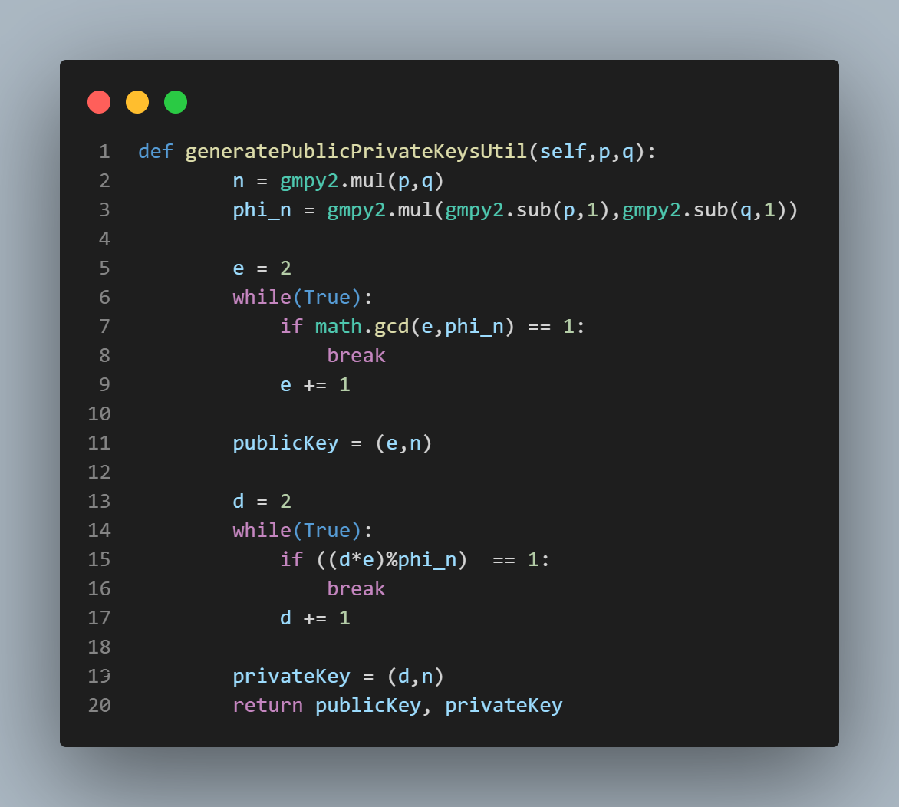
Implementation

Slide 8
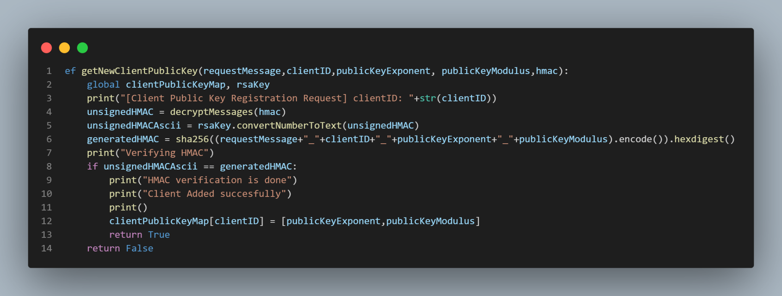

Slide 9
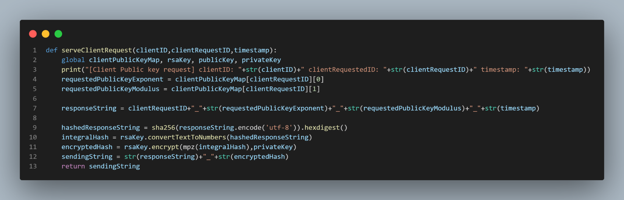

Slide 10
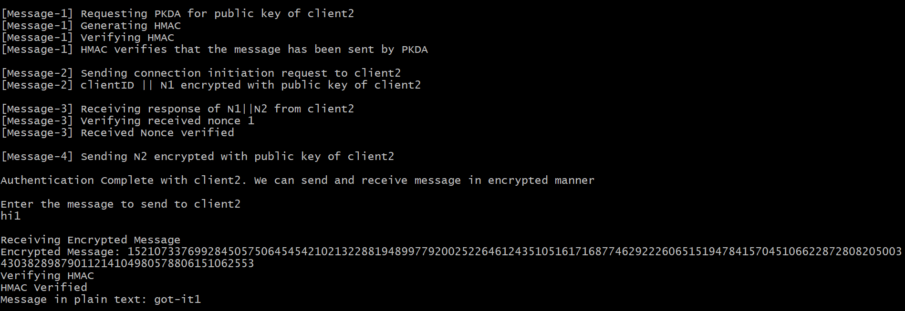
Output of Client-1

Slide 11
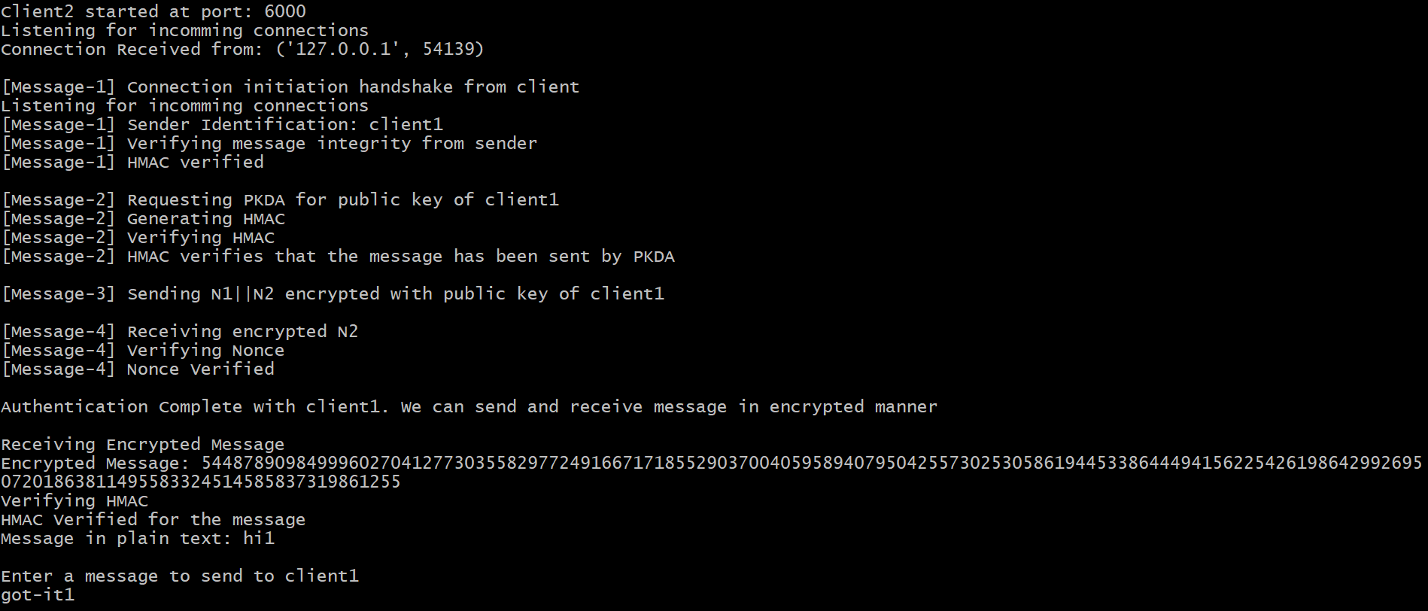
Output of client-2

